Slide 1
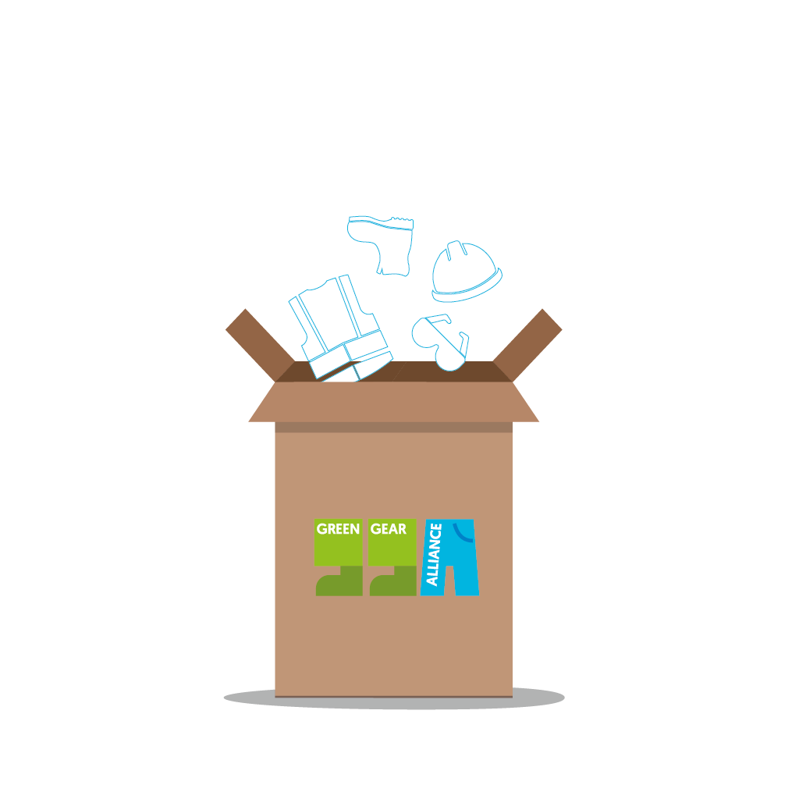
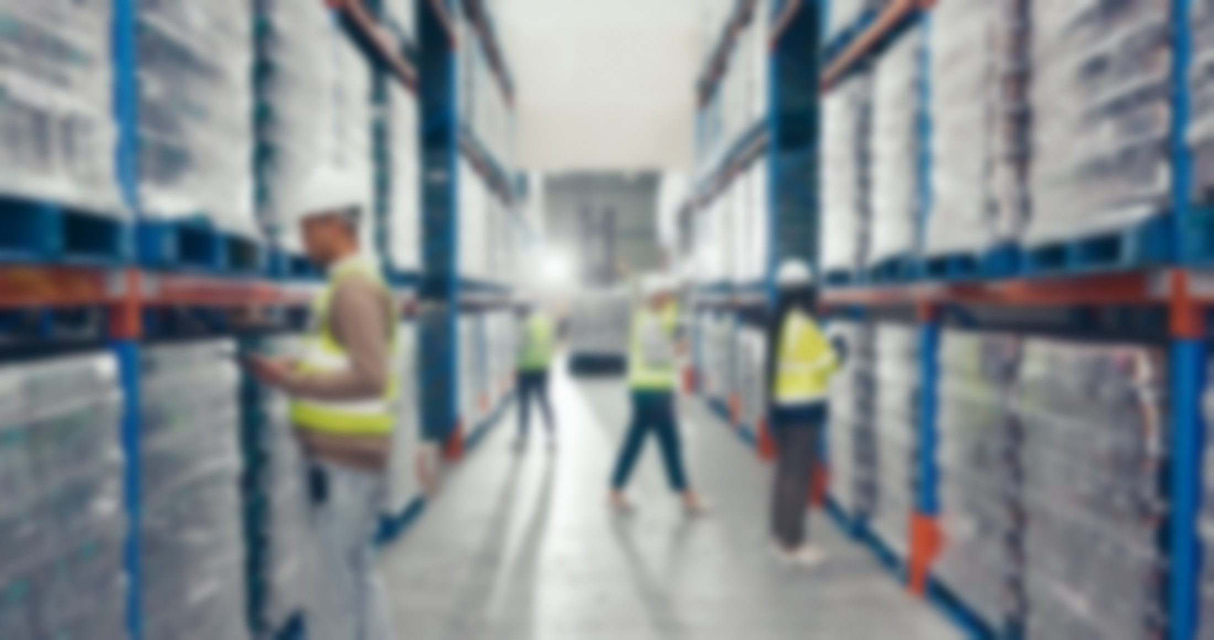


Green Gear Alliance
For reverse logistics
and processing ^{in the Benelux}
of workwear, safety shoes, and other PPE
Go to www.greengearalliance.eu and join as a collection partner!
EU-expansion planned

Slide 2
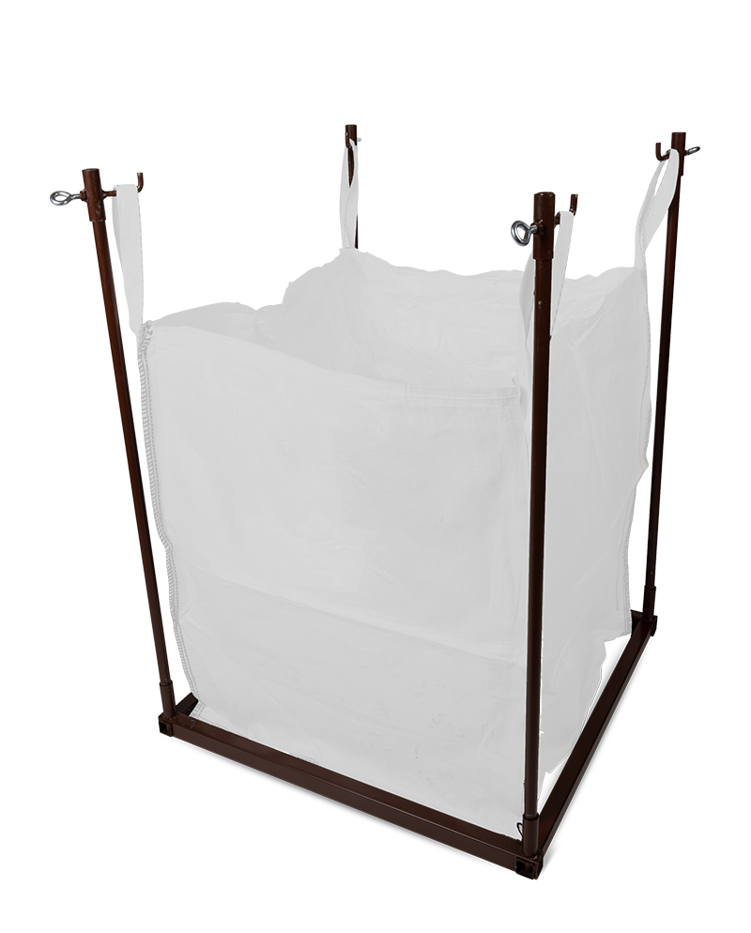
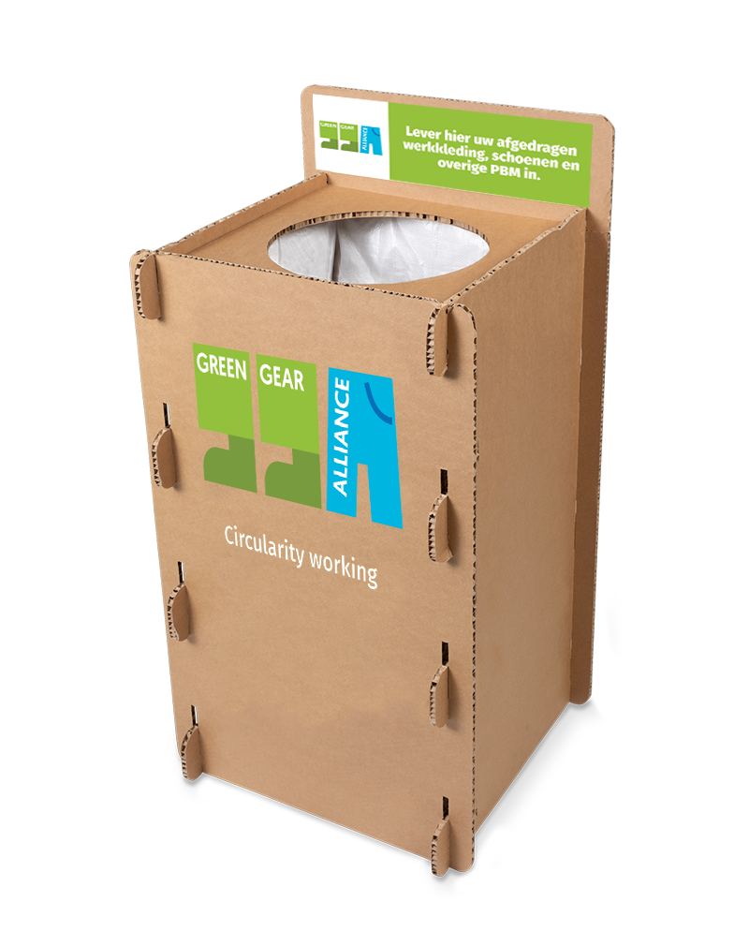


Self-packed
GGA transport
Our collection materials include:
Hassle-free reverse logistics for businesses
Circular contribution and responsible product processing
Insight into your impact
€1,56/kg
  Invoicing afterwards
  Starting from 100 kg
5 MiniBags
+ DisplayBox
BigBag
+ Holder
First time €250,-
Afterwards €175,- | €1.94/kg
First time €390,-
Afterwards €290,- I €1,61/kg
Prices excl. VAT
  Collect up to 5 × 18kg
  Perfect for retail locations
  Collect up to 180kg
  Always place on your own pallet

Slide 3
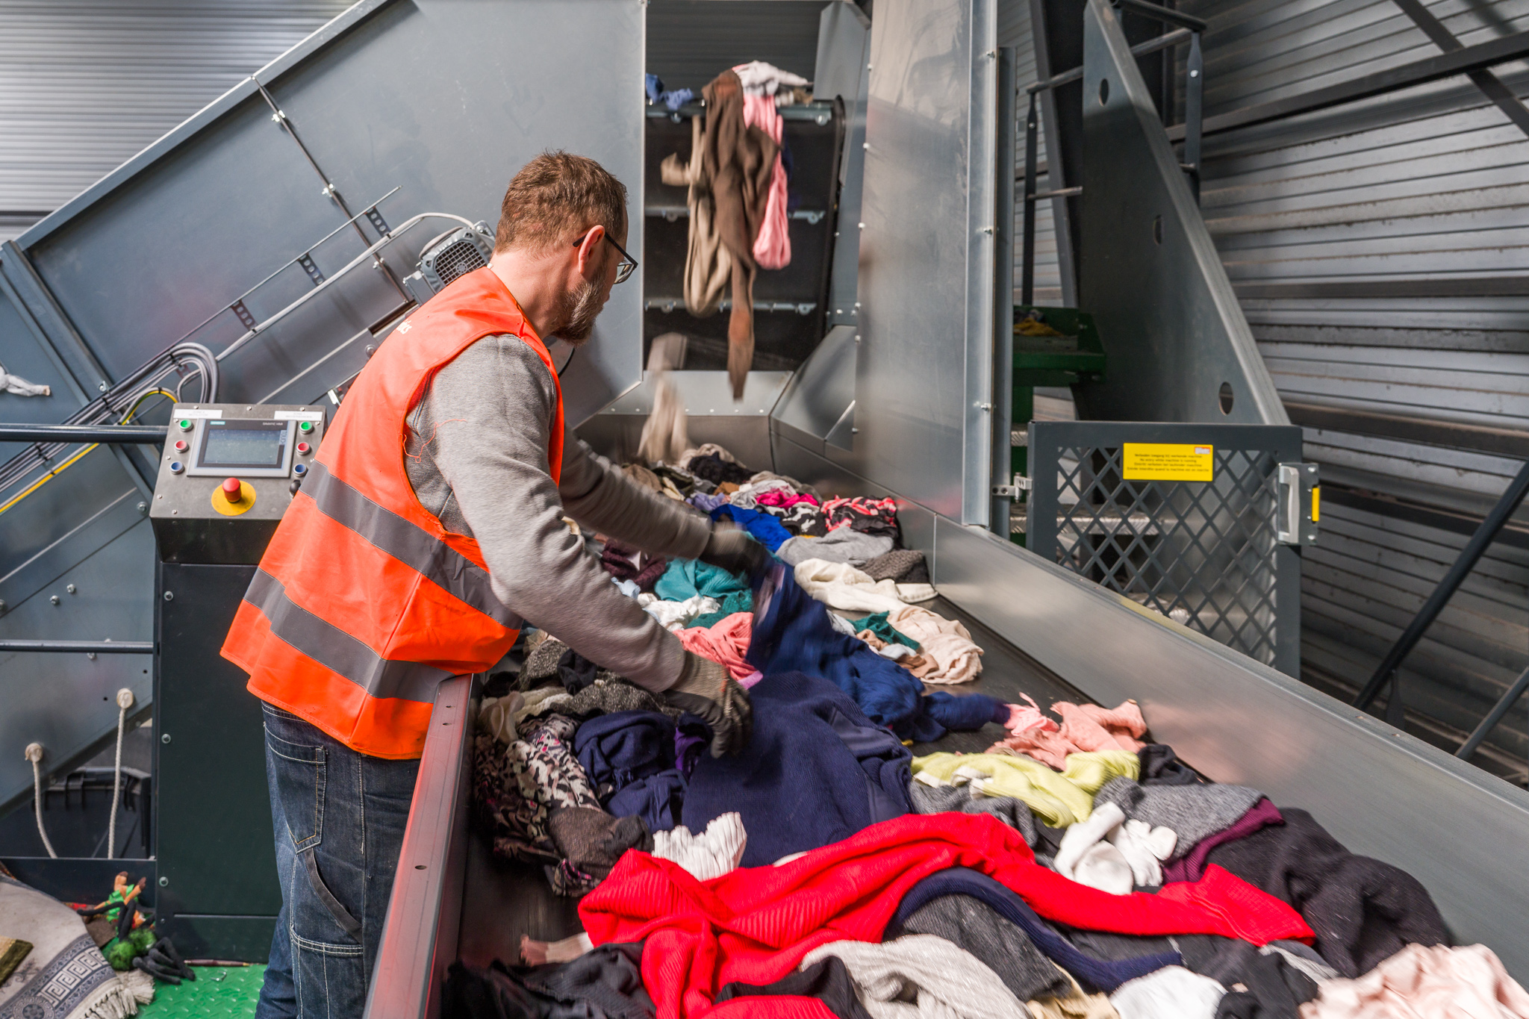
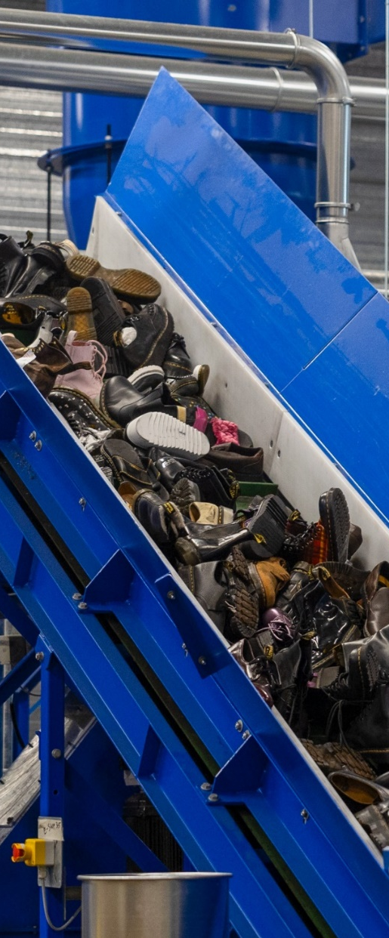
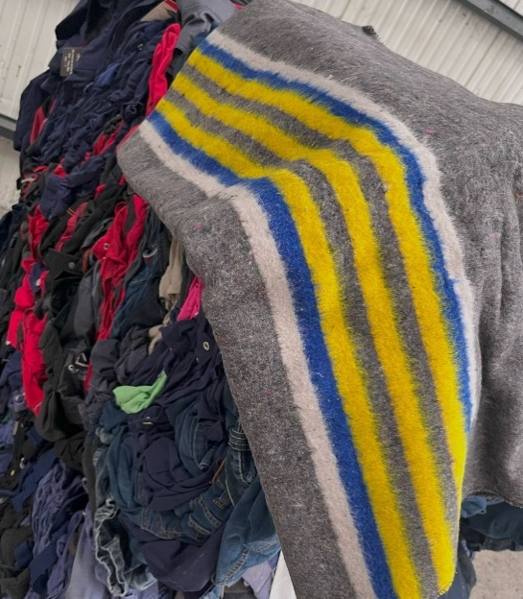
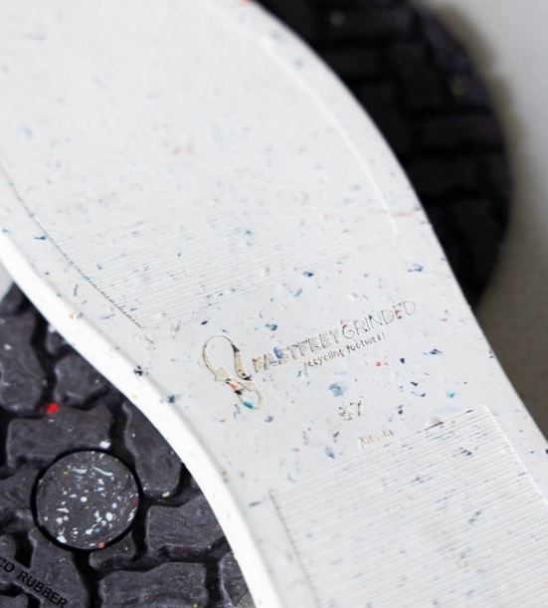
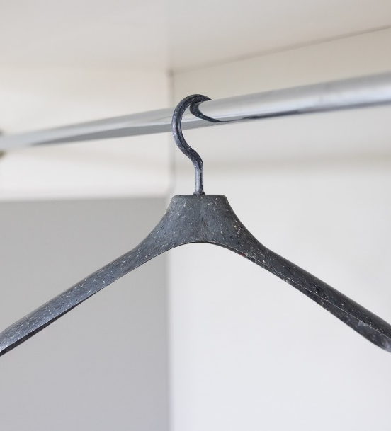
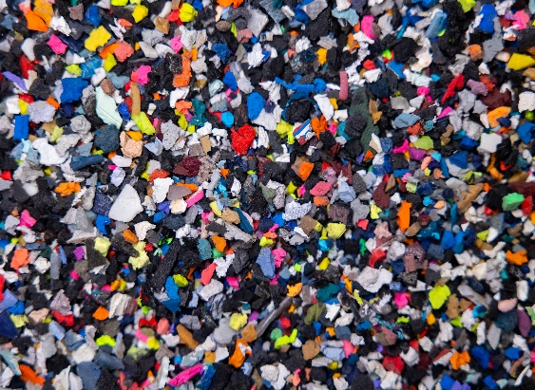

GGA ensures the responsible sorting and processing of workwear, safety shoes, and other personal protective equipment.
GGA for collection partners

Slide 4
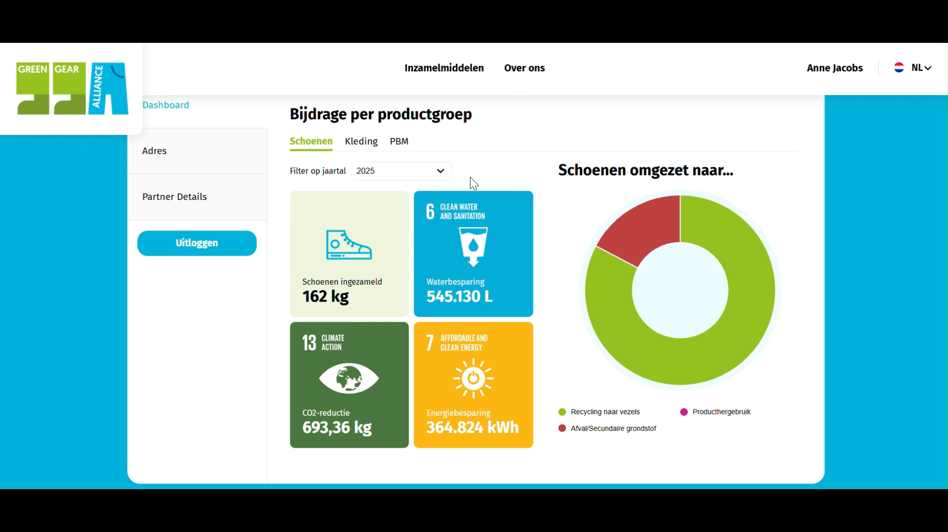
video
Receive an impact report per pickup
Notes:
Impact bekijken

Slide 5















Thanks to
Ask for the participant options

Slide 6
Join as a collection partner
Go to www.greengearalliance.eu
Create an account and order your collection materials
Or email info@greengearalliance.eu
5 MiniBags
+ DisplayBox
BigBag
+ Holder
Would you like to do more than just collect? Ask about the participant options!

Slide 8
Hand in your old workwear with the Green Gear Alliance!
Everything about GGA and
how to get started with collecting

Slide 9
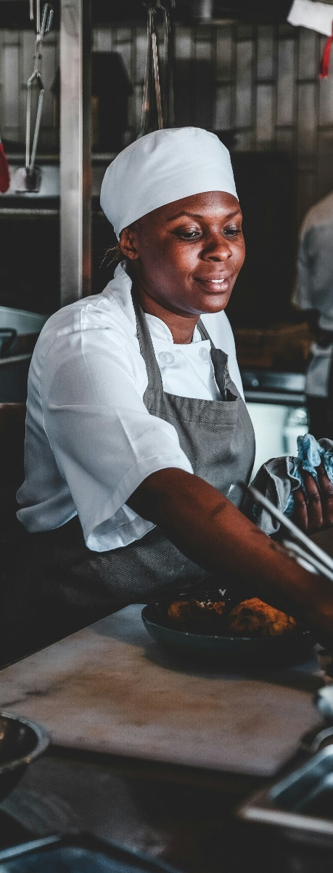
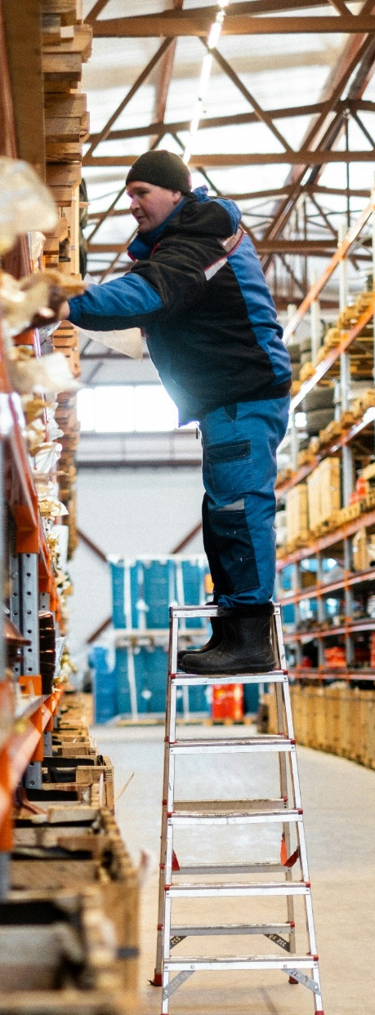
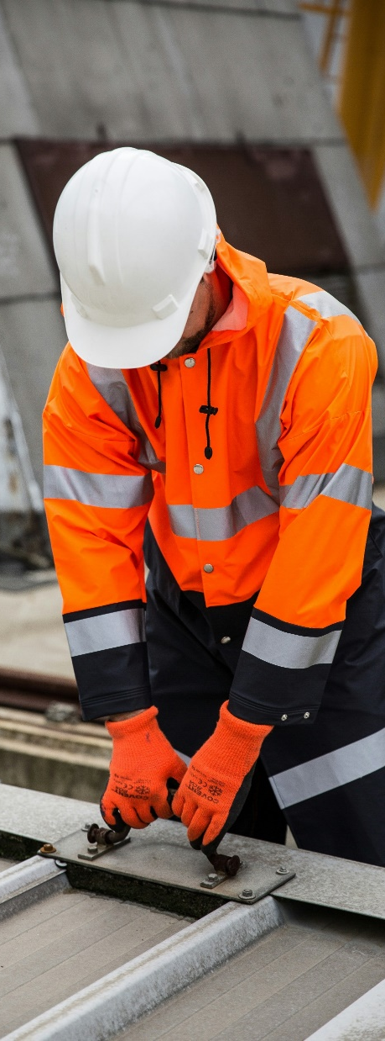
Which characteristics are important when selecting workwear, safety shoes, and other PPE?
Safety, Wearing comfort, Appearance, Quality, Price, …
If we put so much effort into selecting them at the start, isn’t it a shame to let these products end up as waste?
GGA for collection partners

Slide 10




Annual sales of workwear, safety shoes, and other PPE (Netherlands)
Most of these products end up as waste
15 kton of workwear
equal to 15,000,000 kg
Every year, that’s the same as 520 cement mixer trucks dumping their contents straight into the incinerator!
Work textiles
12-15 kton
Safety shoes
3,6 kton
Other PPE
0,9 kton
Estimated

Slide 11
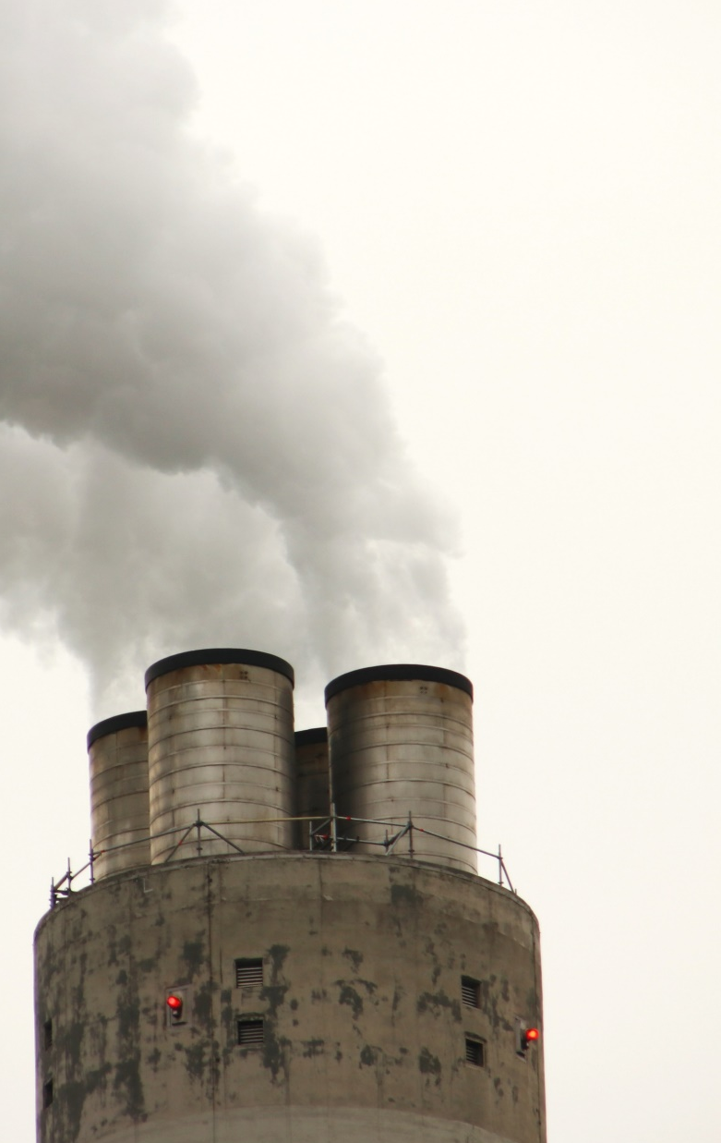
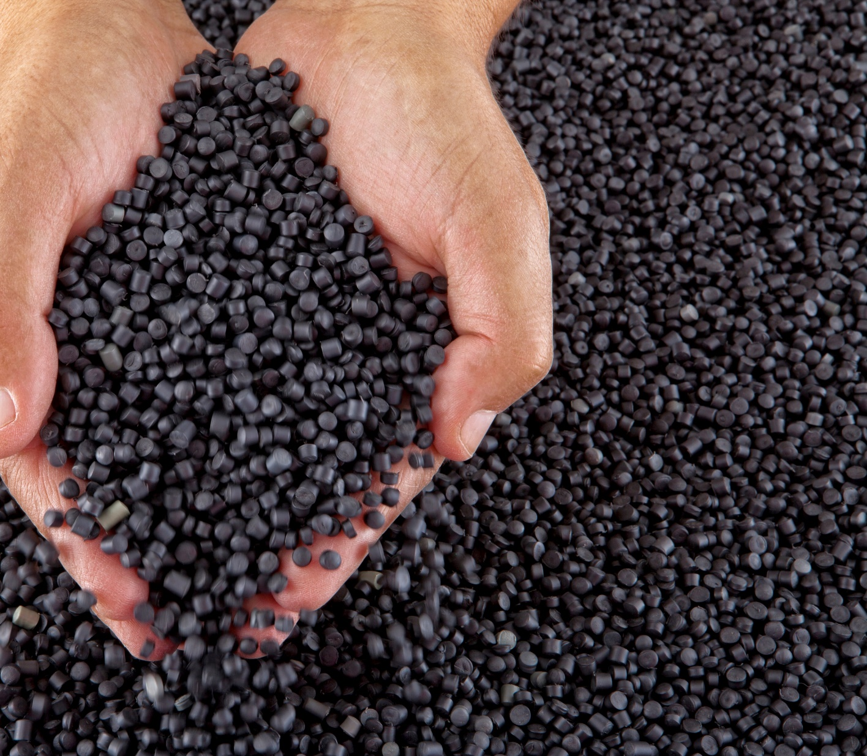
These are valuable raw materials that we save from the incinerator
Webinar GGA voor inzamelpartners

Slide 12
What we stand for
The industry initiative for circular workwear, safety shoes, and other PPE

Slide 13
What we do
For reverse logistics and processing^{*in the Benelux}
of workwear, safety shoes, and other PPE
Join as a collection partner!

Slide 14
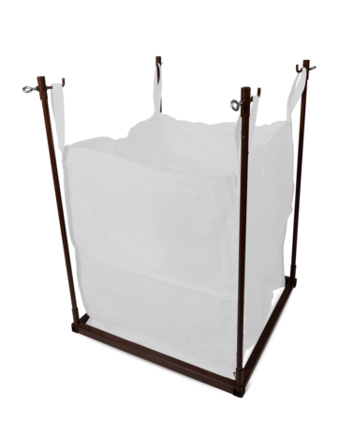
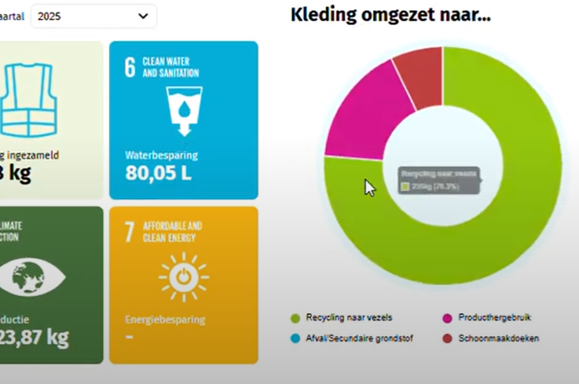
Benefits for GGA collection partners
Circular contribution
By and for the industry, non-profit
Responsible processing of products
You contribute as a collection partner
Hassle-free reverse logistics for businesses
Easy ordering and pickup registration
Confidential processing of clothing with company logos
A partner for (volume) challenges
Insight into your impact
With the GGA dashboard
Usable in your own communication and reporting

Slide 15









The collection process
1. Order collection materials
2. Collect
3. Register pickup
4. View your impact

Slide 16
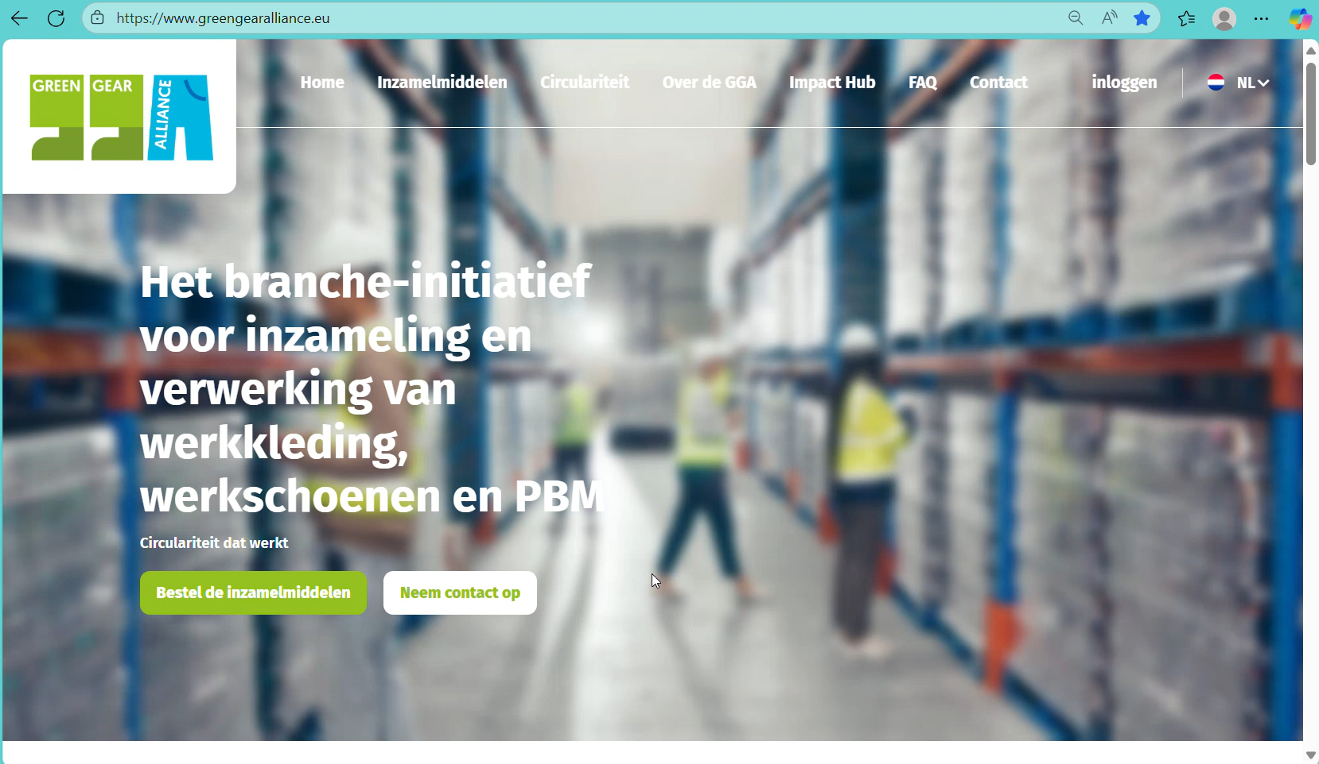
www.greengearalliance.eu
Notes:
1. Aanmelden

Slide 17
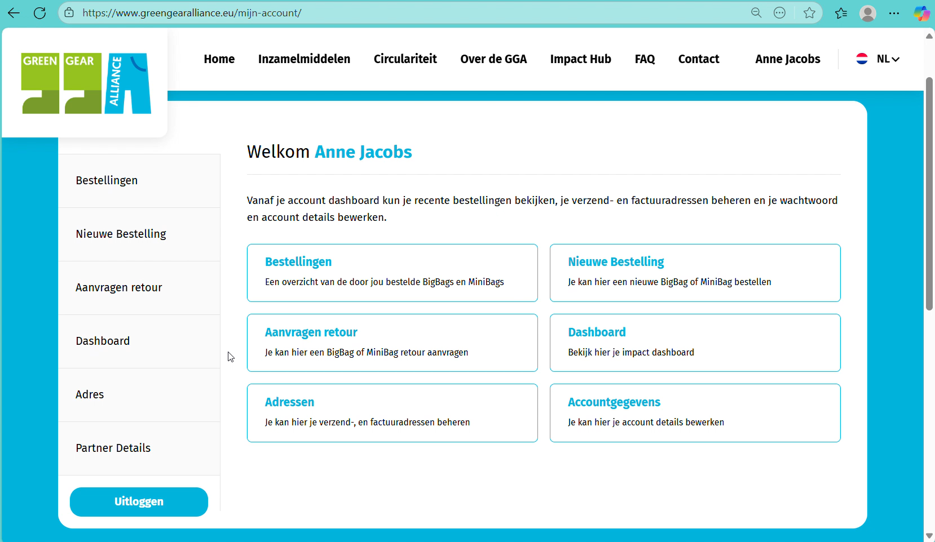
Notes:
2. Inzamelmiddelen bestellen

Slide 18
Self-packed
GGA transport
€1,56/kg
5 MiniBags
+ DisplayBox
BigBag
+ Holder
  Invoicing afterwards Starting from 100 kg
First time €250,-
Afterwards €175,- | €1.94/kg
First time €390,-
Afterwards €290,- | €1.61/kg
  Collect up to 5 × 18kg
  Perfect for retail locations
  Collect up to 180kg
  Always place on your own pallet
All prices excl. VAT

Slide 19


What do we collect?
Workwear, safety shoes & PPE ✅
All brands ✅
❌ Chemically contaminated products
❌ Heavily soiled products
❌ Wet products
❌ Textile scraps

Slide 20
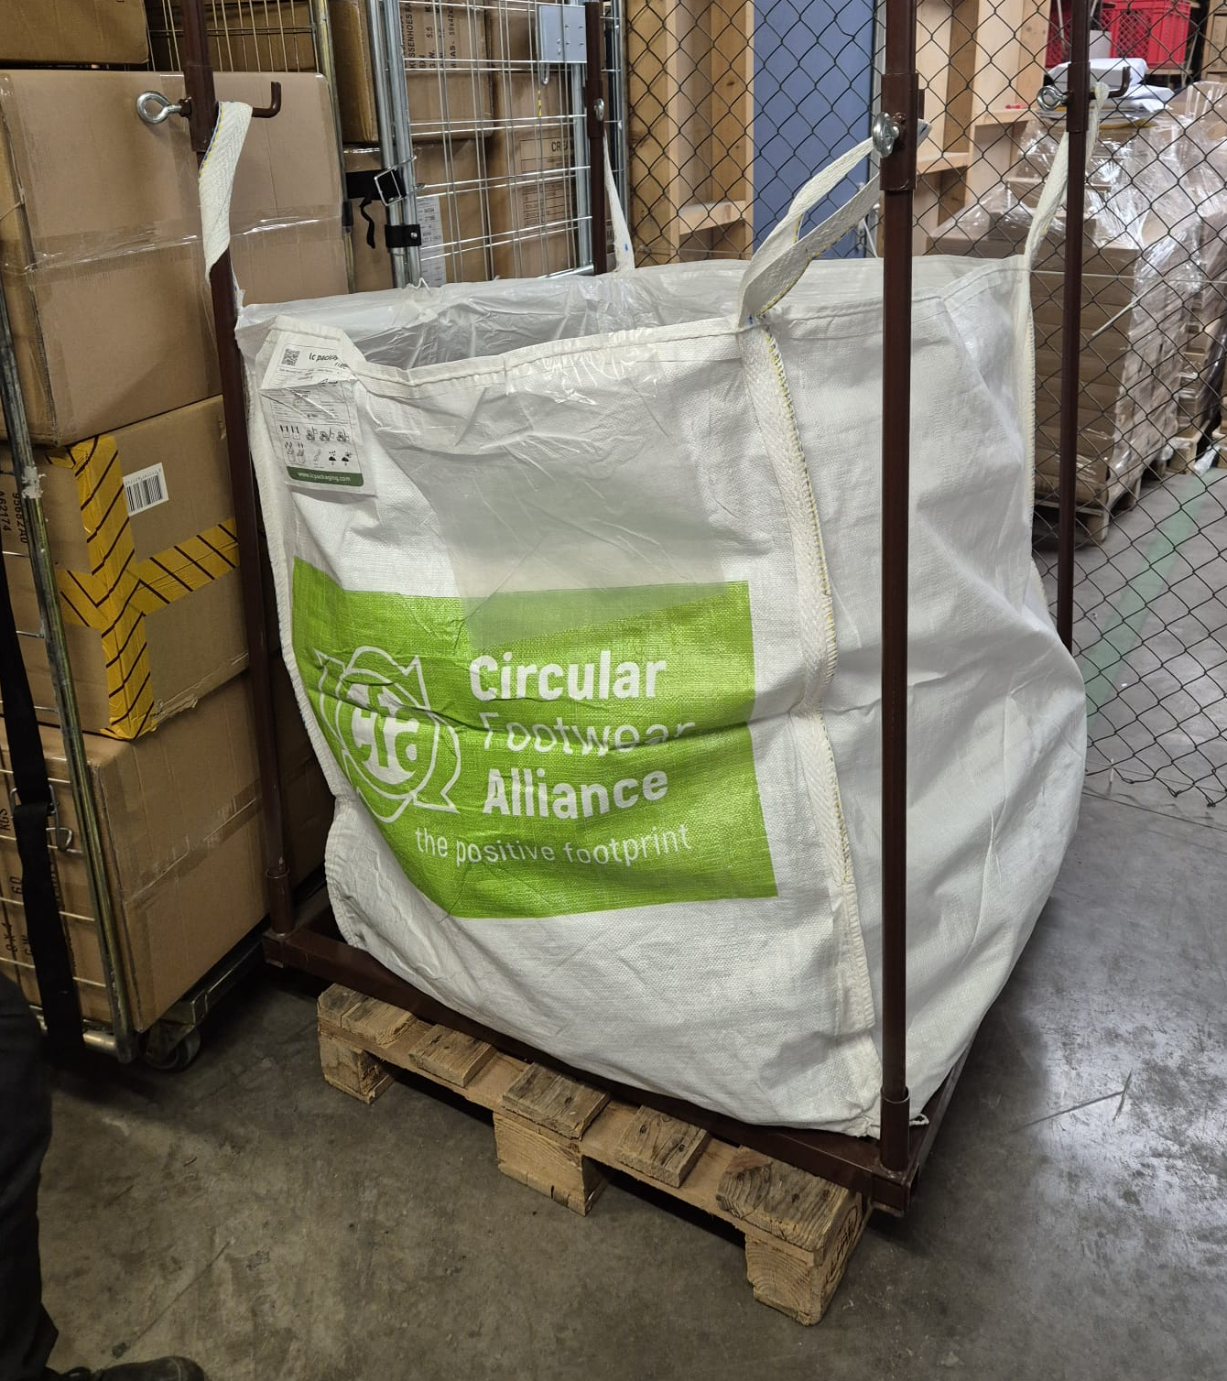
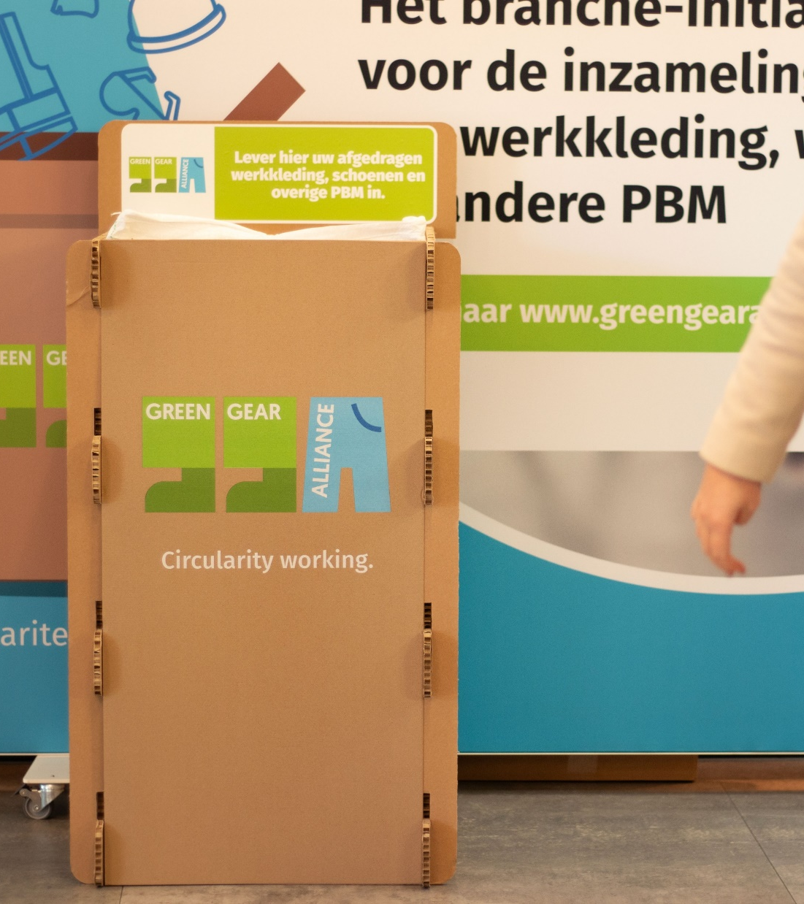
GGA for collection partners

Slide 21
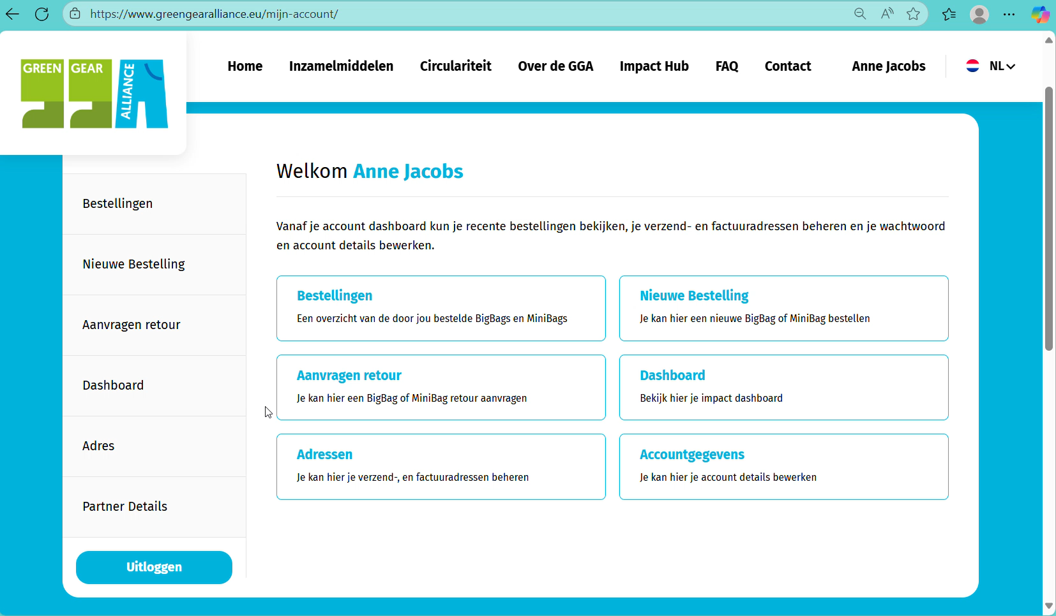
Notes:
3. Retour aanmelden

Slide 22
video
Notes:
4. Impact bekijken

Slide 23
Do’s & Don’ts for collection
Send an internal email about your company’s participation as a GGA collection partner
First order? Order:
  DisplayBox + 5 MiniBags
  BigBag + holder
  Or send an email to info@greengearalliance.eu
Always place BigBags on a pallet
  Don’t have a pallet? Indicate this when placing your order
Template available

Slide 24

We work together with partners for sorting and processing.
Collected products are the property of GGA.
GGA for collection partners

Slide 25

GGA for collection partners

Slide 26
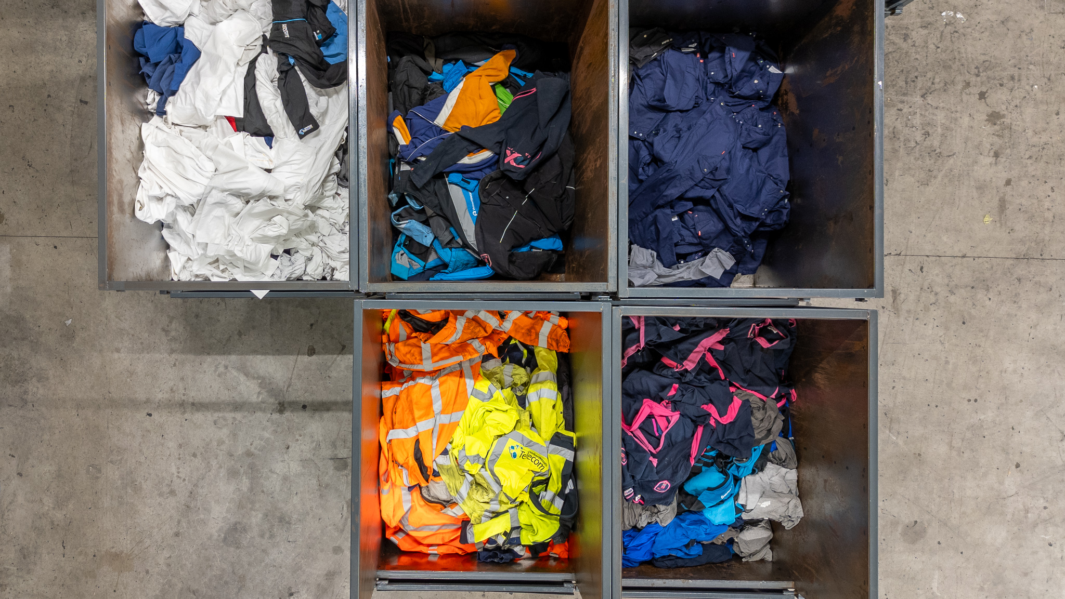
GGA for collection partners

Slide 27
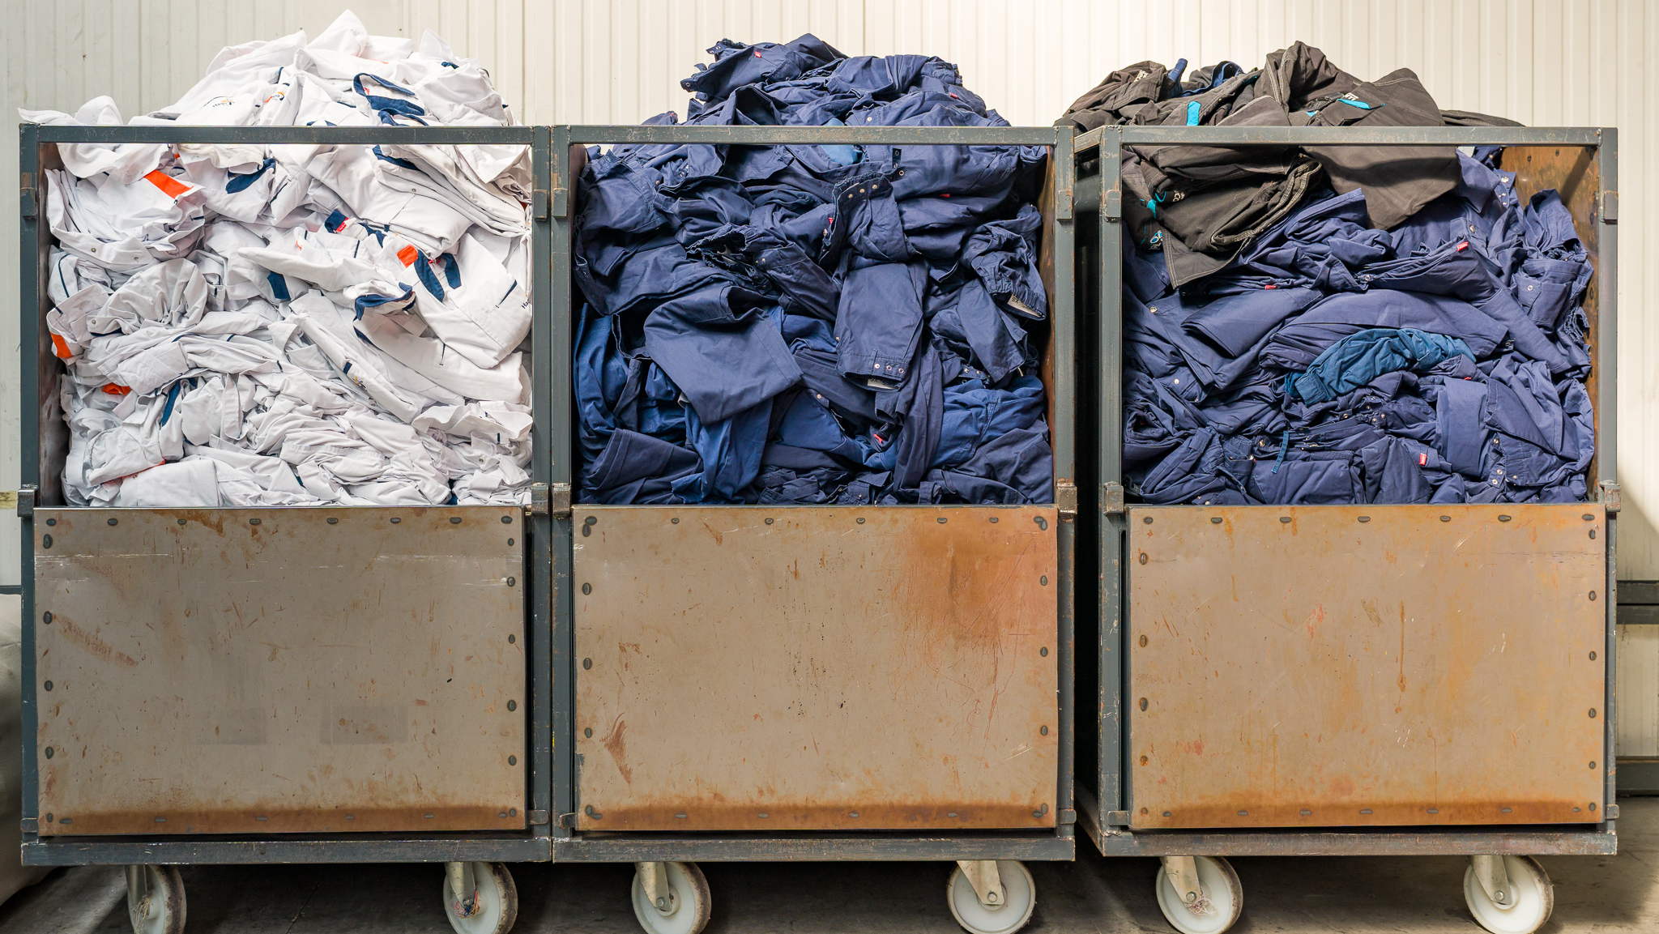
GGA for collection partners

Slide 28
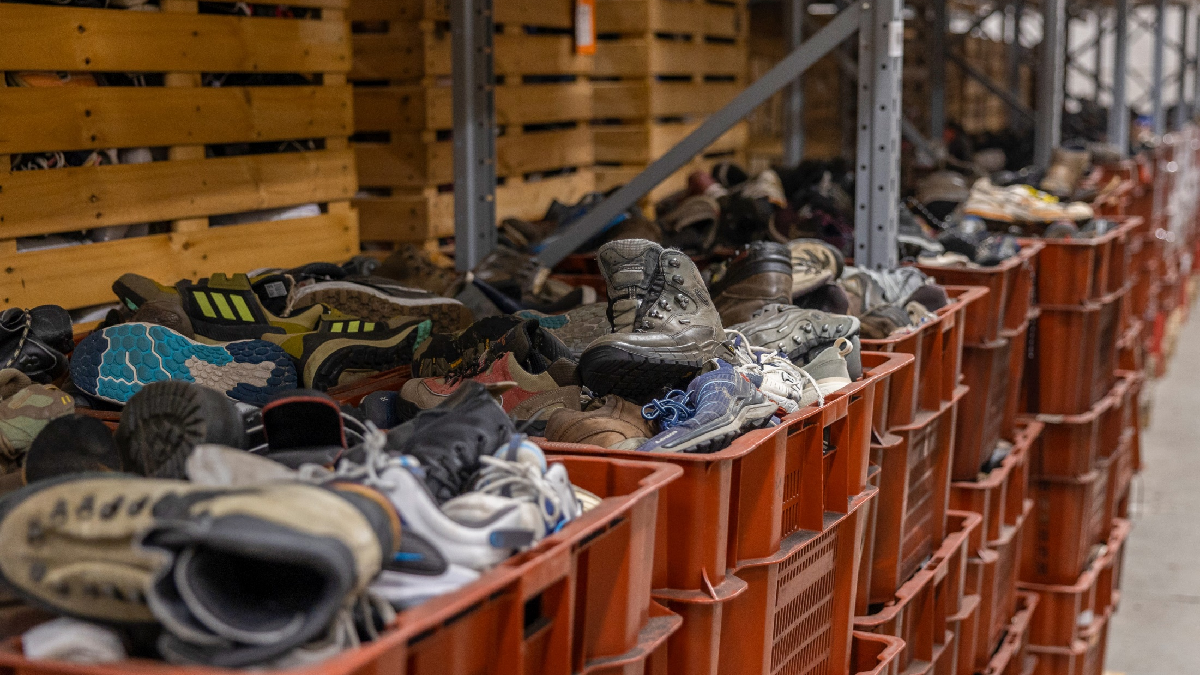

GGA for collection partners

Slide 29
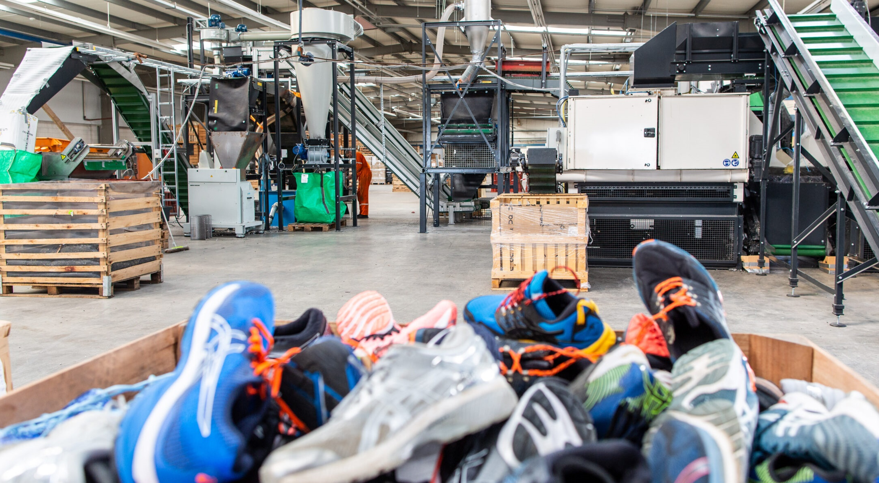
GGA for collection partners

Slide 30
GGA for collection partners

Slide 31

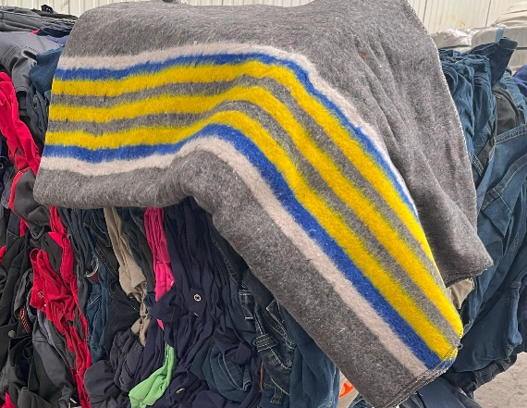
Results April – June
Reuse/ 1%
Reuse 1%
± 12.744 kg
saved for a new purpose
Recycle/ into raw materials and applications 84%
14.000.000 liters of water saved
47.500 kg CO2-emissions reduced
500+
collection points in the Benelux
Repurpose/ into cleaning cloths 14%
Reuse 1%

Slide 32


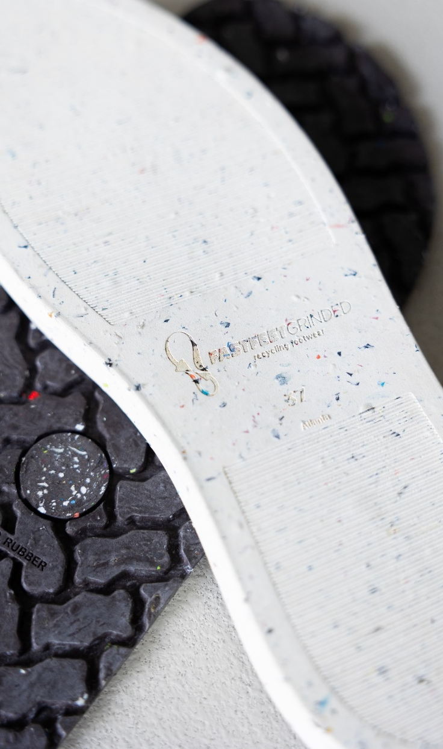
Examples of products from our processing partners.

Slide 33
Green Gear Alliance
The industry initiative for circular workwear, safety shoes, and other PPE
Join as a collection partner
Want more? Ask about our Participant packages

Slide 34
Special thanks to
Join us now

Slide 35
Join as a collection partner
Go to www.greengearalliance.eu
Create an account and order your collection materials
Or email info@greengearalliance.eu
5 MiniBags
+ DisplayBox
BigBag
+ Holder
Would you like to do more than just collect? Ask about the participant options!

